Slide 1

`
EDF-Based Edge-Filter Interrogation
Scheme for FBG Sensors
Based on: U. Tiwari, K. Thyagarajan, M. R. Shenoy and S. C. Jain, "EDF-Based Edge-Filter Interrogation Scheme for FBG Sensors," in IEEE Sensors Journal, vol. 13, no. 4, pp. 1315-1319, April 2013.
Presenter: Ashish Kumar
Student ID: 108998404
Instructor: Prof. Peng-chun Peng
Based on: U. Tiwari, K. Thyagarajan, M. R. Shenoy and S. C. Jain, "EDF-Based Edge-Filter Interrogation Scheme for FBG Sensors," in IEEE Sensors Journal, vol. 13, no. 4, pp. 1315-1319, April 2013.
Presenter: Ashish Kumar
Student ID: 108998404
Instructor: Prof. Peng-chun Peng

Slide 2
OUTLINE
Proposed work
Introduction
Principle
Experiment and Results
Conclusion

Slide 3
PROPOSED WORK
A FBG sensor employing an interrogation scheme based on EDF edge detection filter with enhanced detection bandwidth and intrinsic temperature insensitivity is proposed and experimentally demonstrated.

Slide 4
INTRODUCTION
Low cost, small size, wavelength coding and being immune to electromagnetic interference.
The interrogator for sensing with multiple FBG sensors simultaneously over a relatively large wavelength range and without the need for any temperature compensation.
FBG
Temperature, Pressure and Strain

Slide 5
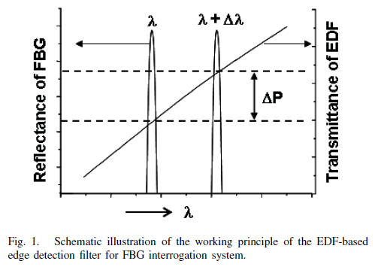
PRINCIPLE

Slide 6
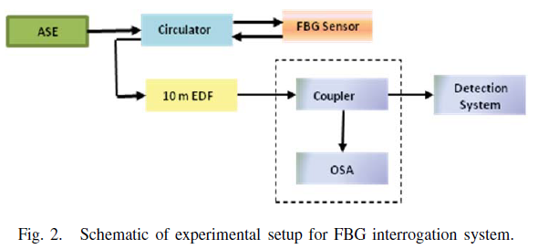
EXPERIMENT AND RESULTS
50:50
Monitoring & calibration purpose
ASE: amplified spontaneous emission source (1mV average power)

Slide 7
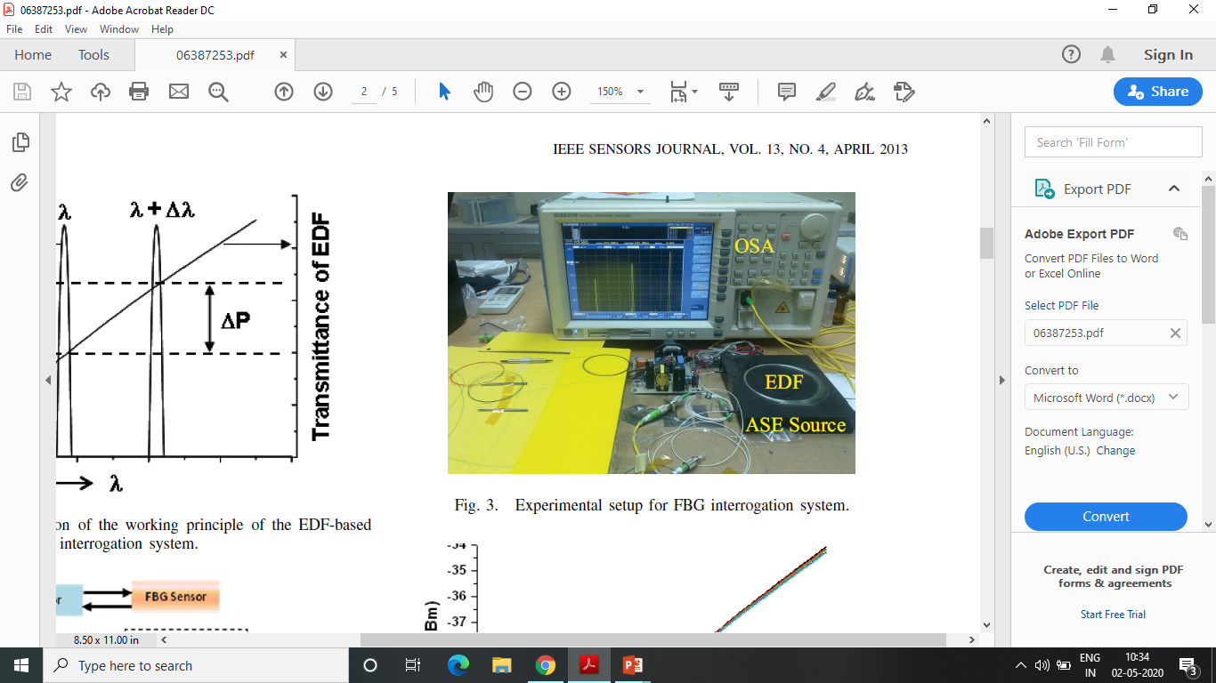

Slide 8
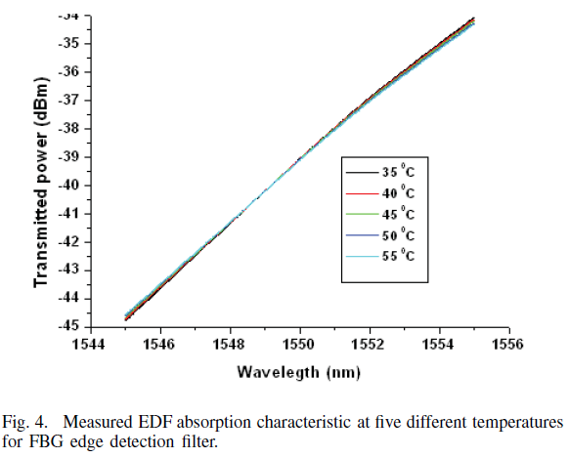
Study of temperature dependence of EDF
The filter has a slope of 1 dB/nm over the wavelength range of 1545 nm to 1555 nm.

Slide 9
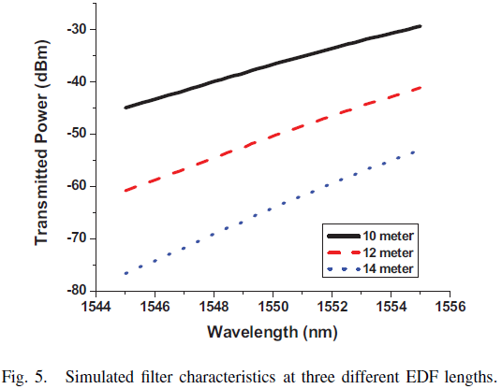
Slope efficiency of the EDF edge detection filter can be further enhanced by increasing the length of the EDF at the cost of overall transmitted power.

Slide 10
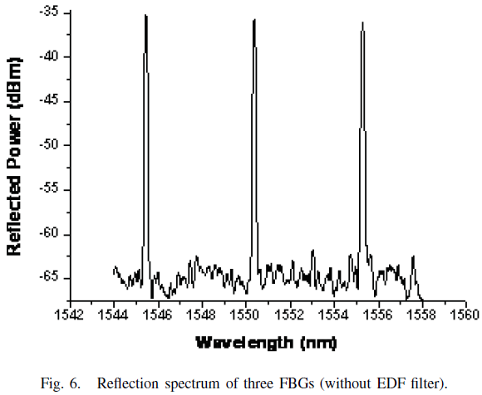

Slide 11
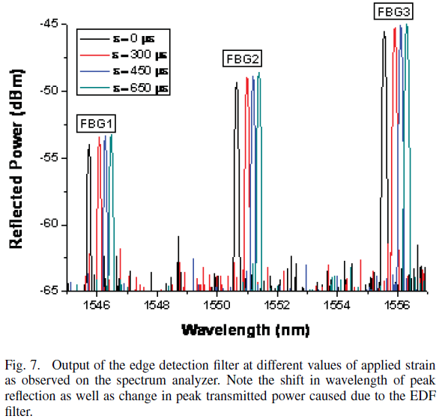
Conventional measurement one would have to measure the changes in the peak reflected wavelength.
Proposed edge detection filter
the changes in the peak reflected wavelengths from the FBGs result in a corresponding change in the total transmitted power after passing through the edge filter.

Slide 12
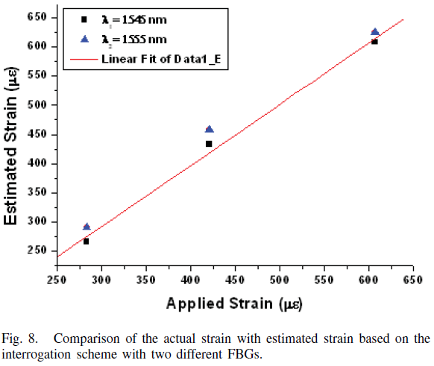
slope of the variation ≈1
It is possible to measure strain by using the EDF edge detection filter.

Slide 13
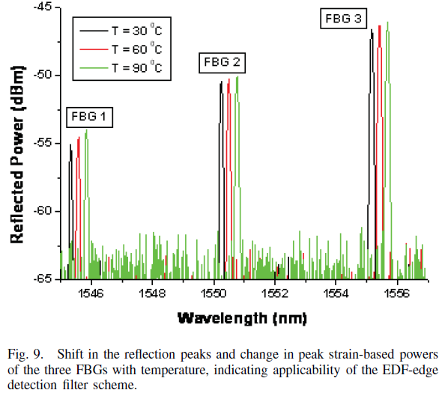
Strain and temperature resolution using the above scheme is estimated to be 20 με and 2.0 °C corresponding to minimum change in measurable power from the filter.

Slide 14
CONCLUSION
Authors have proposed and demonstrated a novel FBG sensor interrogation scheme based on EDF edge-detection filter.
Scheme offers better slope efficiency over a wider wavelength range.
Multiple FBG interrogation is possible by this method using wavelength division multiplexing technique and at any range of wavelength by a proper choice of the doped fiber.
This technique provides a simple and cost-effective solution for FBG interrogation with higher range of strain and temperature measurement.

Slide 15
Thank You!!

